Slide 1
UAC – Technical Details

Slide 2
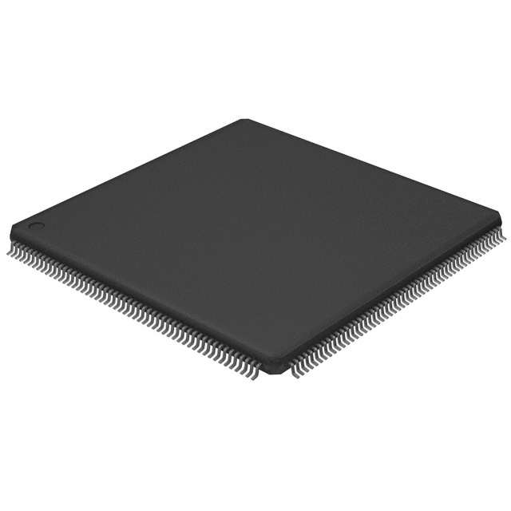
LPC2478 ARM7
Some specifications on the LPC2478…
  LQFP Package
  72 MHz
  Why we choose it:
  -The LPC2478 is a relatively inexpensive
  chip.
  -It has all the features we needed,
  SPI interface, internal clock, decent on
  Chip memory storage, UART for debugging,
  External memory controller, MCI interface for
  SD/MCC cards, and plenty of GPIO pins.

Slide 3
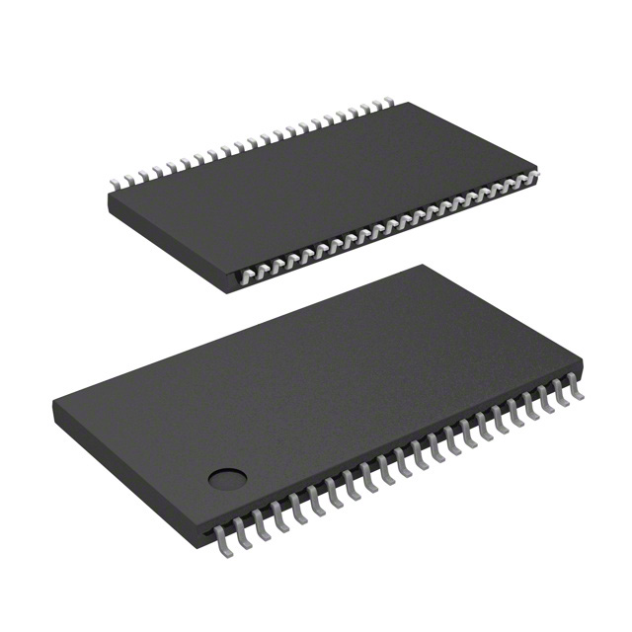
4M (256K x 16) SRAM
High Speed CMOS Static RAM
Why we choose it:
  It’s fast. Ideal for storing larges amounts of data
  and quickly reading and writing
  (pictures and video frames).
  -- SRAMs are simple. Just a large lookup table.
  -- The External Memory Controller on the LPC2478
  easily recognizes and utilizes the SRAM.

Slide 4
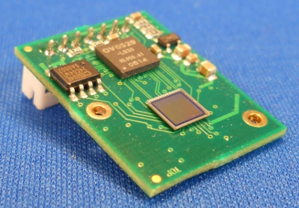
C329 SPI CMOS Camera
Digital Camera with SPI interface
Why we choose it:
--It has the SPI interface, which is
ideal for transfer speeds
(faster than UART)
--Offers JPEG image compression
--Offers resolutions up to 640x480.
and interchangeable lenses.

Slide 5
Transmitter/Receiver Module
Transmitter/Receiver Module provided RF communication between the transmitter board and the receiver board.
The transmitter board has 4 pushbuttons, which when pressed generate an interrupt to the receiver, providing the different functions.
On the receiver end, the detection of the buttons are hooked up via GPIO pins, thus generate a GPIO interrupt.

Slide 6
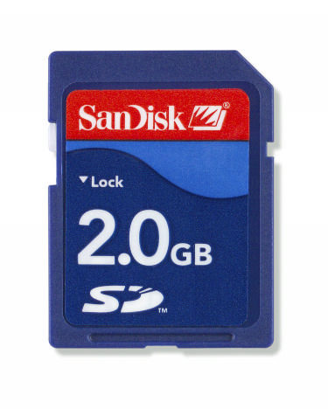
Secure Digital (SD Card)
Why we choose it:
  Open standard, lots of open source code
  The SD card is the industry standard in terms of memory cards.
  Relatively inexpensive and offers ample storage

Slide 7
The things we did right…
Choosing this project!
  Fun project, involved multimedia, which is always fun to work with pictures and video
  Allowed us to get exposure of working with embedded systems.
  Teamwork
  - Worked diligently as a team, collaborated, and helped each other when needed.
  - Encouraged others, boosted each others moral
  - We all pulled our weight, and did our best to deliver results

Slide 8
Things we learned the hard way
Choosing parts!
  Be very careful when choosing parts. Make sure enough research is done before buying and make sure documentation is clear, accurate, and that support is available!
  This is especially true with our camera, the user’s manual and datasheet are poorly
  written, have conflicting information, and technical support offers little help!

Slide 9
Project Credits
Baker Ngan – Ported MCI/FAT File system code over. Worked on SRAM implementation as well as some of the transmitter/receiver modules.
Changhao Huang – Contributed to the interrupt handlers, FAT File System ,transmitter/receiver modules, soldering, project assembly, and code integration.
Danny Trinh – Worked on the SPI interface, SRAM,UART interface, and implementation of the camera.
Perry Yang – Worked on the camera module, SPI interface, poster, and UART interface.

